Slide 1
VLSM & CIDR
Notes:
VLSM = Variable Length Subnet Mask
CIDR = Classless Inter Domain Routing

Slide 2
Classful addressing

Slide 3
Network part and host part

Slide 4
Classful networks
Address class | First octet range | Number of networks | Hosts per network
Class A | 0 to 127 | 128 (less 0 and 127) | 16,777,214
Class B | 128 to 191 | 16,348 | 65,534
Class C | 192 to 229 | 2,097,152 | 254

Slide 5
Some Class A owners
General Electric Company US Defense (various) IBM DoD Intel AT&T Bell Laboratories Xerox Corporation Hewlett-Packard Company Digital Equipment Corp Apple Computer Inc. MIT Ford Motor Company | UK Ministry of Defence UK Social Security Dept AT&T Global Network Halliburton Company Eli Lily and Company Bell-Northern Research Prudential Securities Inc. E.I. duPont de Nemours Merck and Co., Inc. DoD Network Information U.S. Postal Service

Slide 6
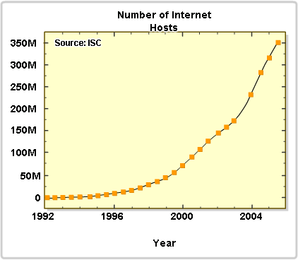
Not enough addresses
We would have run out of version 4 addresses some time ago if we still used only classful addresses.

Slide 7
Solutions
Long term – change to IP version 6. Plenty of addresses using a different scheme
Use VLSM and CIDR to avoid wasting addresses
Use private addresses locally and NAT for internet access – lets many hosts share a few public addresses
Notes:
NAT = Network Address Translation

Slide 8
Classful Subnetting
Subnetting can be used with a classful addressing system, but all subnets of a main network must have the same subnet mask. This means that they must all have the same number of hosts.

Slide 9
Subnet 192.168.1.0
10 hosts
26 hosts
12 hosts
Need 6 networks, up to 26 hosts.
Borrow 3 bits, /27, 255.255.255.224
Gives 8 networks, up to 30 hosts.
Point to point need 2. 28x3 = 84 wasted

Slide 10
Subnet 172.16.0.0
100 hosts
500 hosts
350 hosts
Need 6 networks, up to 500 hosts.
Borrow 7 bits, /23, 255.255.254.0
Gives 128 networks, up to 510 hosts.
Point to point need 2. 508x3 = 1524 wasted
Notes:
510 = 2⁹ - 2

Slide 11
Waste
Classful subnetting wastes addresses.
If you are using private addresses then you may not be bothered.
Waste of public addresses does matter.

Slide 12
Classful routing protocol
Fine if subnets are all the same size (same subnet mask) and are contiguous.
Cannot cope with subnets of different sizes or discontiguous subnets.
Notes:
Contiguous = berdekatan.
Cope = mengatasi.

Slide 13
New system needed
But classful addressing cannot cope with the demand any more.
Classful addressing gives very large routing tables
Classless InterDomain Routing (CIDR) introduced 1993 by IETF.

Slide 14
Address allocation before CIDR
Need 10 addresses
Class C. Give them 256.
Need 200 addresses
Class C. Give them 256.
Need 500 addresses
Class B. Give them 65,536.
Need 1000 addresses
Class B. Give them 65,536.
Need 4000 addresses
Class B. Give them 65,536.

Slide 15
Address allocation with CIDR
Need 10 addresses
/28. Give them 16.
Need 200 addresses
/24. Give them 256.
Need 500 addresses
/23. Give them 512.
Need 1000 addresses
/22. Give them 1024.
Need 4000 addresses
/20. Give them 4096.
Notes:
CIDR = Classless Inter Domain Routing

Slide 16
Routing tables
Before CIDR all known classful networks had to be listed separately
2113628 potential classful networks (though default routes could help)
With CIDR networks can be aggregated into groups and summary routes put into routing tables.
Notes:
Aggregated = dikumpulkan

Slide 17
VLSM
Variable length subnet masks (VLSM) go with CIDR
When subnetting, you do not have to give all the subnets the same mask.
You can “subnet the subnets” and have different sizes of subnet.
Fit the addressing requirements better into the address space – less space needed.

Slide 18
Route summarization
201.1.0.0/22
201.1.4.0/23
Advertise?
201.1.6.0/24
201.1.7.0/24

Slide 19
Route summarization
Octet 3 in binary
00000000 00000100 00000110 00000111
201.1.0.0/22
201.1.4.0/23
201.1.6.0/24
201.1.7.0/24
Same
Difference starts here
Same
Difference starts here
21 bits the same so use /21 for summary

Slide 20
Route summarization
201.1.0.0/22
Advertise 201.1.0.0/21
201.1.4.0/23
201.1.6.0/24
Summary mask is less than individual masks
201.1.7.0/24

Slide 21
Route summarisation
What address would summarise:
170.16.0.0/16
170.17.0.0/17
170.17.128.0/17
15 the same altogether
170.16.0.0/15
Octet 2 in binary
00010000 00010001 00010001
7 the same here

Slide 22
Classless routing protocol
With classless addressing you cannot tell the mask from the address.
You need to be told the mask every time.
Routers need a routing protocol that includes subnet mask information in its updates.
RIPv2, EIGRP, OSPF, IS-IS, BGP do this.

Slide 23
Summary routes
You can create static summary routes.
Dynamic routes can be summarised.
Classless routing protocols can forward both.
Classful routing protocols do not because the receiving router would not recognise them.

Slide 24
Subnetting the subnet
172.16.0.0/16
Borrow 3 bits from octet 3
Gives 2³ = 8 subnets
Mask 255.255.224.0 or /19
How do we get the network addresses?
172.16.0.0
172.16.32.0
172.16.64.0
172.16.96.0
172.16.128.0
172.16.160.0
172.16.192.0
172.16.224.0

Slide 25
Subnetting 172.16.0.0/16
Borrowing from octet 3
Write octet 3 of mask in binary
172.16. 0 .0
172.16. 32 .0
172.16. 64 .0
172.16. 96 .0
172.16.128.0
172.16.160.0
172.16.192.0
172.16.224.0
mask | 11100000
Use all possible combinations of subnet bits for addresses
subnet 1 subnet 2 subnet 3 etc. | 00000000 00100000 01000000

Slide 26
Another way of looking at it
Row 1 = Bits borrowed
Row 2 = Prefix (16 + bits borrowed for octet 3)
Row 3 = Value of bit. Add this to get next network
Row 4 = Add row 3 values so far to get mask
1 | 2 | 3 | 4 | 5 | 6 | 7 | 8
17 | 18 | 19 | 20 | 21 | 22 | 23 | 24
128 | 64 | 32 | 16 | 8 | 4 | 2 | 1
128 | 192 | 224 | 240 | 248 | 252 | 254 | 255

Slide 27
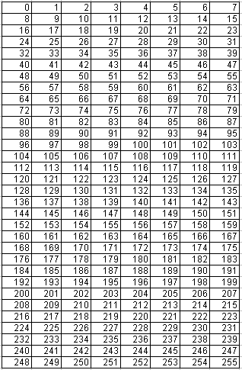
Yet another way
Show all 256 values in the address space – here it is octet 3
Borrow 1: slice
Borrow 2: slice
Borrow 3: slice
0, 32, 64, 96, 128, 160, 192, 224

Slide 28
Subnetting the subnet
So far so good.
Borrowed 3 bits, got 8 equal sized subnets.
Now take subnet 172.16.192.0/19 and borrow 2 more bits
New mask is /21
172.16.0.0
172.16.32.0
172.16.64.0
172.16.96.0
172.16.128.0
172.16.160.0
172.16.192.0
172.16.224.0
mask | 11111000

Slide 29
Subnetting 172.16.192.0/19
Working in octet 3
2 more bits borrowed
2² = 4 sub-subnets
Total of 5 bits borrowed
172.16.192.0
172.16.200.0
172.16.208.0
172.16.216.0
mask | 11111000
8 more would be 224 but that is not in 172.16.192.0/19
This bit is increased for each subnet address – add 8 each time

Slide 30
Another way of looking at it
Row 1 = Bits borrowed
Row 2 = Prefix (16 + bits borrowed for octet 3)
Row 3 = Value of bit. Add this to get next network
Row 4 = Add row 3 values so far to get mask
1 | 2 | 3 | 4 | 5 | 6 | 7 | 8
17 | 18 | 19 | 20 | 21 | 22 | 23 | 24
128 | 64 | 32 | 16 | 8 | 4 | 2 | 1
128 | 192 | 224 | 240 | 248 | 252 | 254 | 255

Slide 31
Yet another way
Subnetting 172.16.192.0/19
Borrow 1 more: slice
Borrow 2 more: slice
192, 200, 208, 216

Slide 32
Subnetting the subnet
172.16.0.0/19
172.16.32.0/19
172.16.64.0/19
172.16.96.0/19
172.16.128.0/19
172.16.160.0/19
172.16.192.0/19
172.16.224.0 /19
172.16.192.0/21
172.16.200.0/21
172.16.208.0/21
172.16.216.0/21

Slide 33
Subnetting 172.16.0.0/16
172.16.0.0/20
172.16.16.0/20
172.16.32.0/20
172.16.48.0/20
172.16.64.0/20
172.16.80.0/20
172.16.96.0/20
172.16.112.0 /20
172.16.128.0/20
172.16.144.0/20
172.16.160.0/20
172.16.176.0/20
172.16.192.0/20
172.16.208.0/20
172.16.224.0/20
172.16.240.0 /20
172.16.32.0/22
172.16.36.0/22
172.16.40.0/22
172.16.44.0/22

Slide 34
Hal-hal yang perlu dipertimbangkan ketika merancang suatu jaringan komputer:
Berapa jumlah total subnet yang dibutuhkan saat ini.
Berapa jumlah total subnet yang dibutuhkan untuk masa mendatang.
Berapa banyak host yang ada di subnet terbesar saat ini.
Berapa banyak host yang akan ada di subnet terbesar pada masa mendatang.

Slide 35
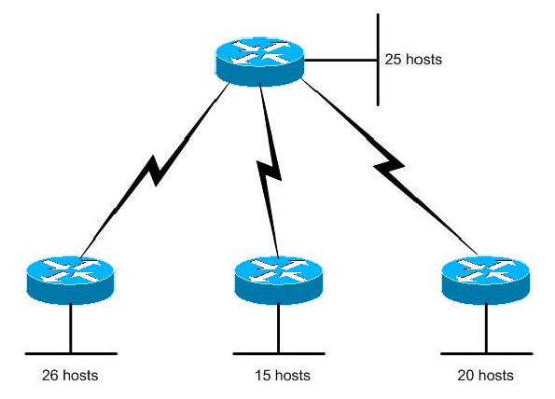
Problem 1: Membuat Skema Pengalamatan Menggunakan VLSM
Jaringan 192.168.15.0

Slide 36
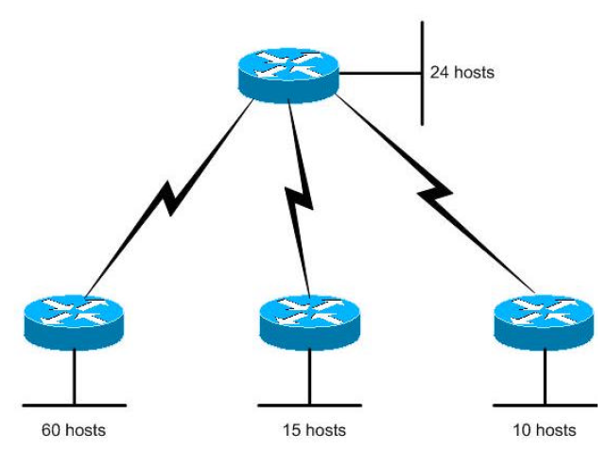
Problem 2: Membuat Skema Pengalamatan Menggunakan VLSM
Jaringan 192.168.15.0

Slide 37
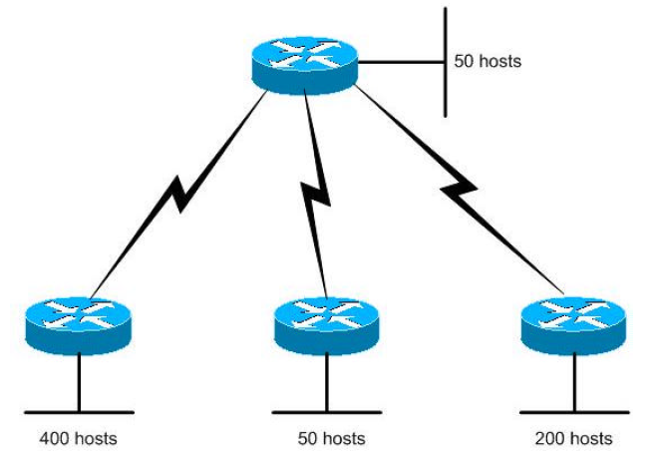
Problem 3
Jaringan 172.16.0.0 /16

Slide 38
Problem 4
Diberikan suatu alamat CIDR: 192.168.24.0 /24 dan akan mendukung jaringan seperti gambar di atas. Buatlah suatu skema pengalamatan yang memenuhi syarat seperti yang digambarkan.

